Slide 1
EDA CREDIT analysis
By: Anush goel

Slide 2
Problem STATEMENT
Understanding the factors that contribute to loan default and determining which factors are strong predictors of future default
This is accomplished by employing EDA (exploratory data analysis) on bank data, in which we analyse data patterns and assist banks in mitigating two categories of risk connected with loan approvals:
If the person seeking financing is likely to repay the loan, the organisation loses revenue by not authorising the loan.
If the applicant is unlikely to repay the loan, i.e., is in probable default, accepting the loan may result in a financial loss for the company.

Slide 3
Steps
Understanding Data and sourcing
Data Quality and Binning Checking
Data imbalance, Correlation, urivariate, Segmented Univariate Analysis and bivariate analysis
Merging Datasets with Previous Application History
Data analysis by urivariate and bivariate analysis
Recommendations

Slide 4
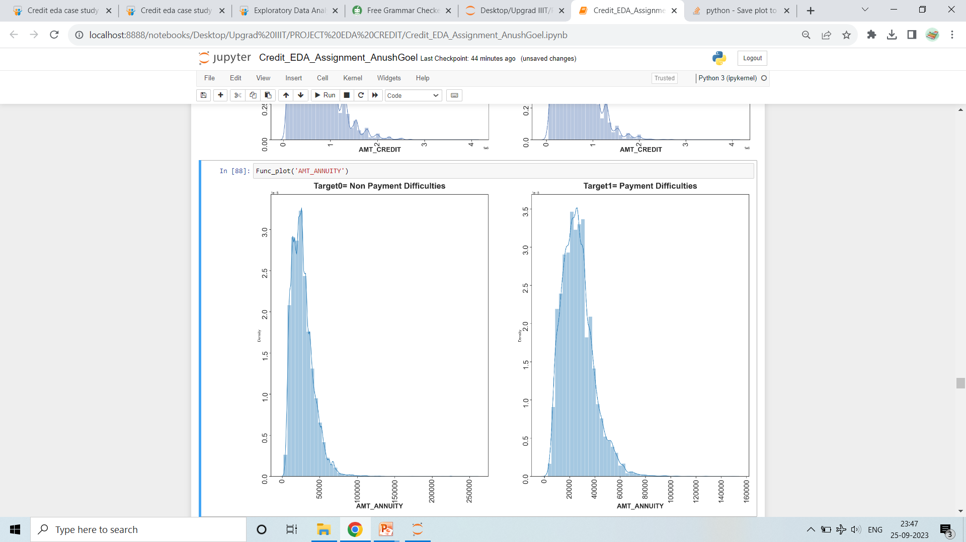
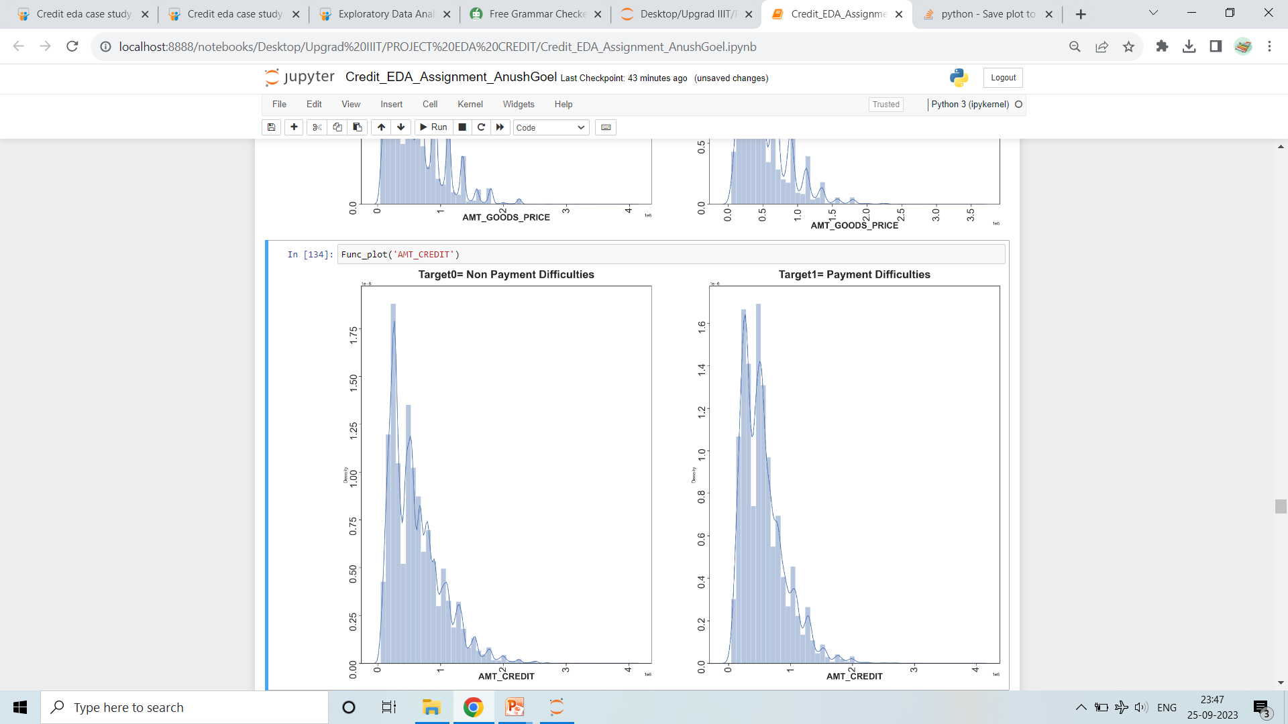
Urivariate analysis
>Those with target one have a far more scattered income than those with target zero. The plot clearly shows that the shape of income total, annuity, credit, and good price is the same for Targets 0 and 1.

Slide 5
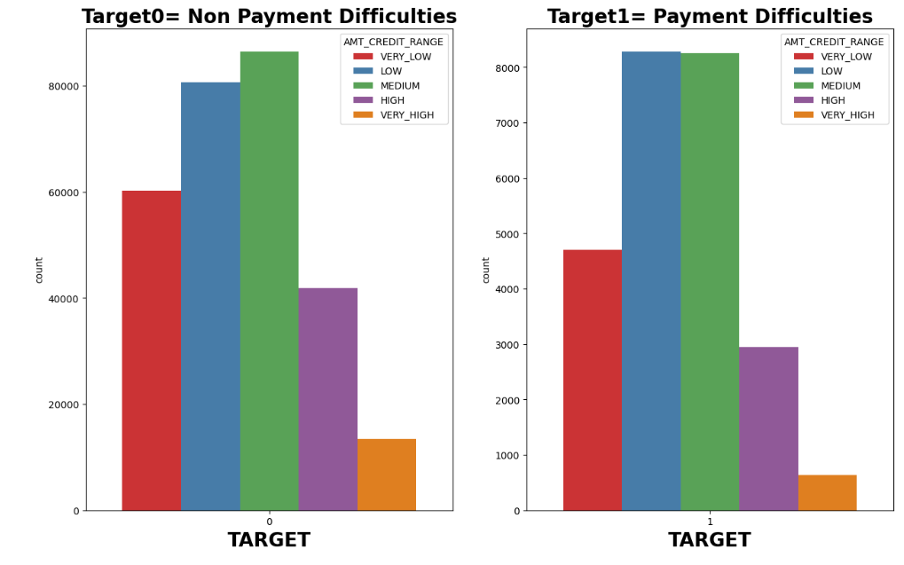
INCOME CATEGORY
Segmented Univariate Analysis
Clients with medium salary range are having more number of credits and 93 percent are non Defaulter.
10 percent of total Clients in low salary range who had taken loan are Defaulter

Slide 6
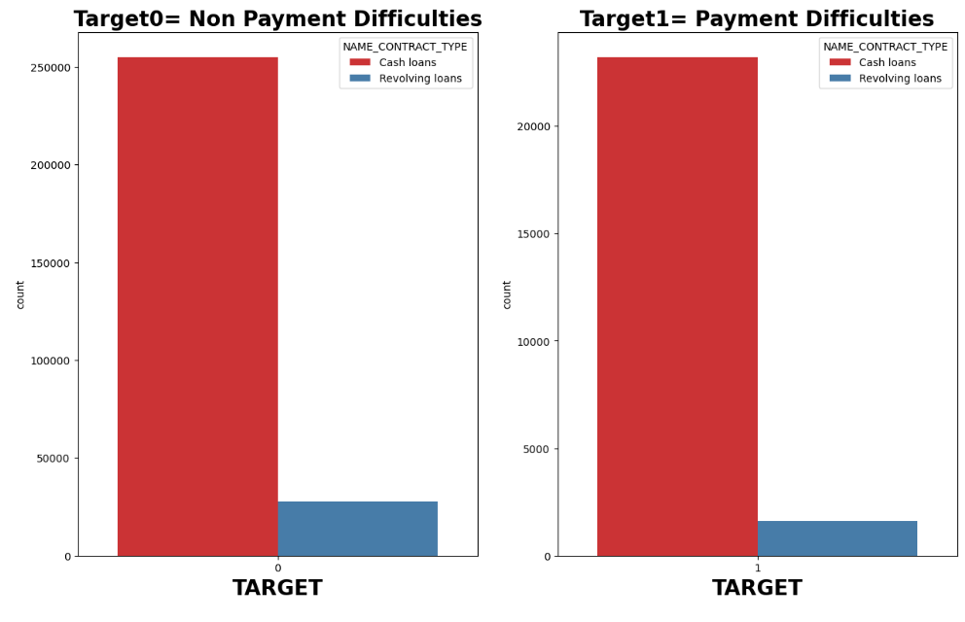
CONTRACT TYPE
The majority of customers have requested cash loans, while relatively few have requested revolving loans to both defaulters and non-defaulters.

Slide 7
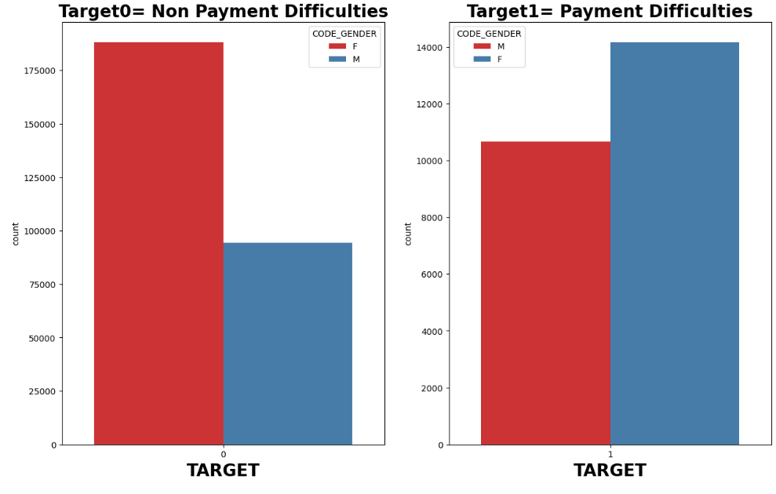
Gender Category
FEMALE HAD APPLIED MORE THAN MALE
Non-Defaulter ratio= 67 percent of Females and 33 Percent of males
Defaulter ratio= 58 percent of Females and 42 percent of males

Slide 8
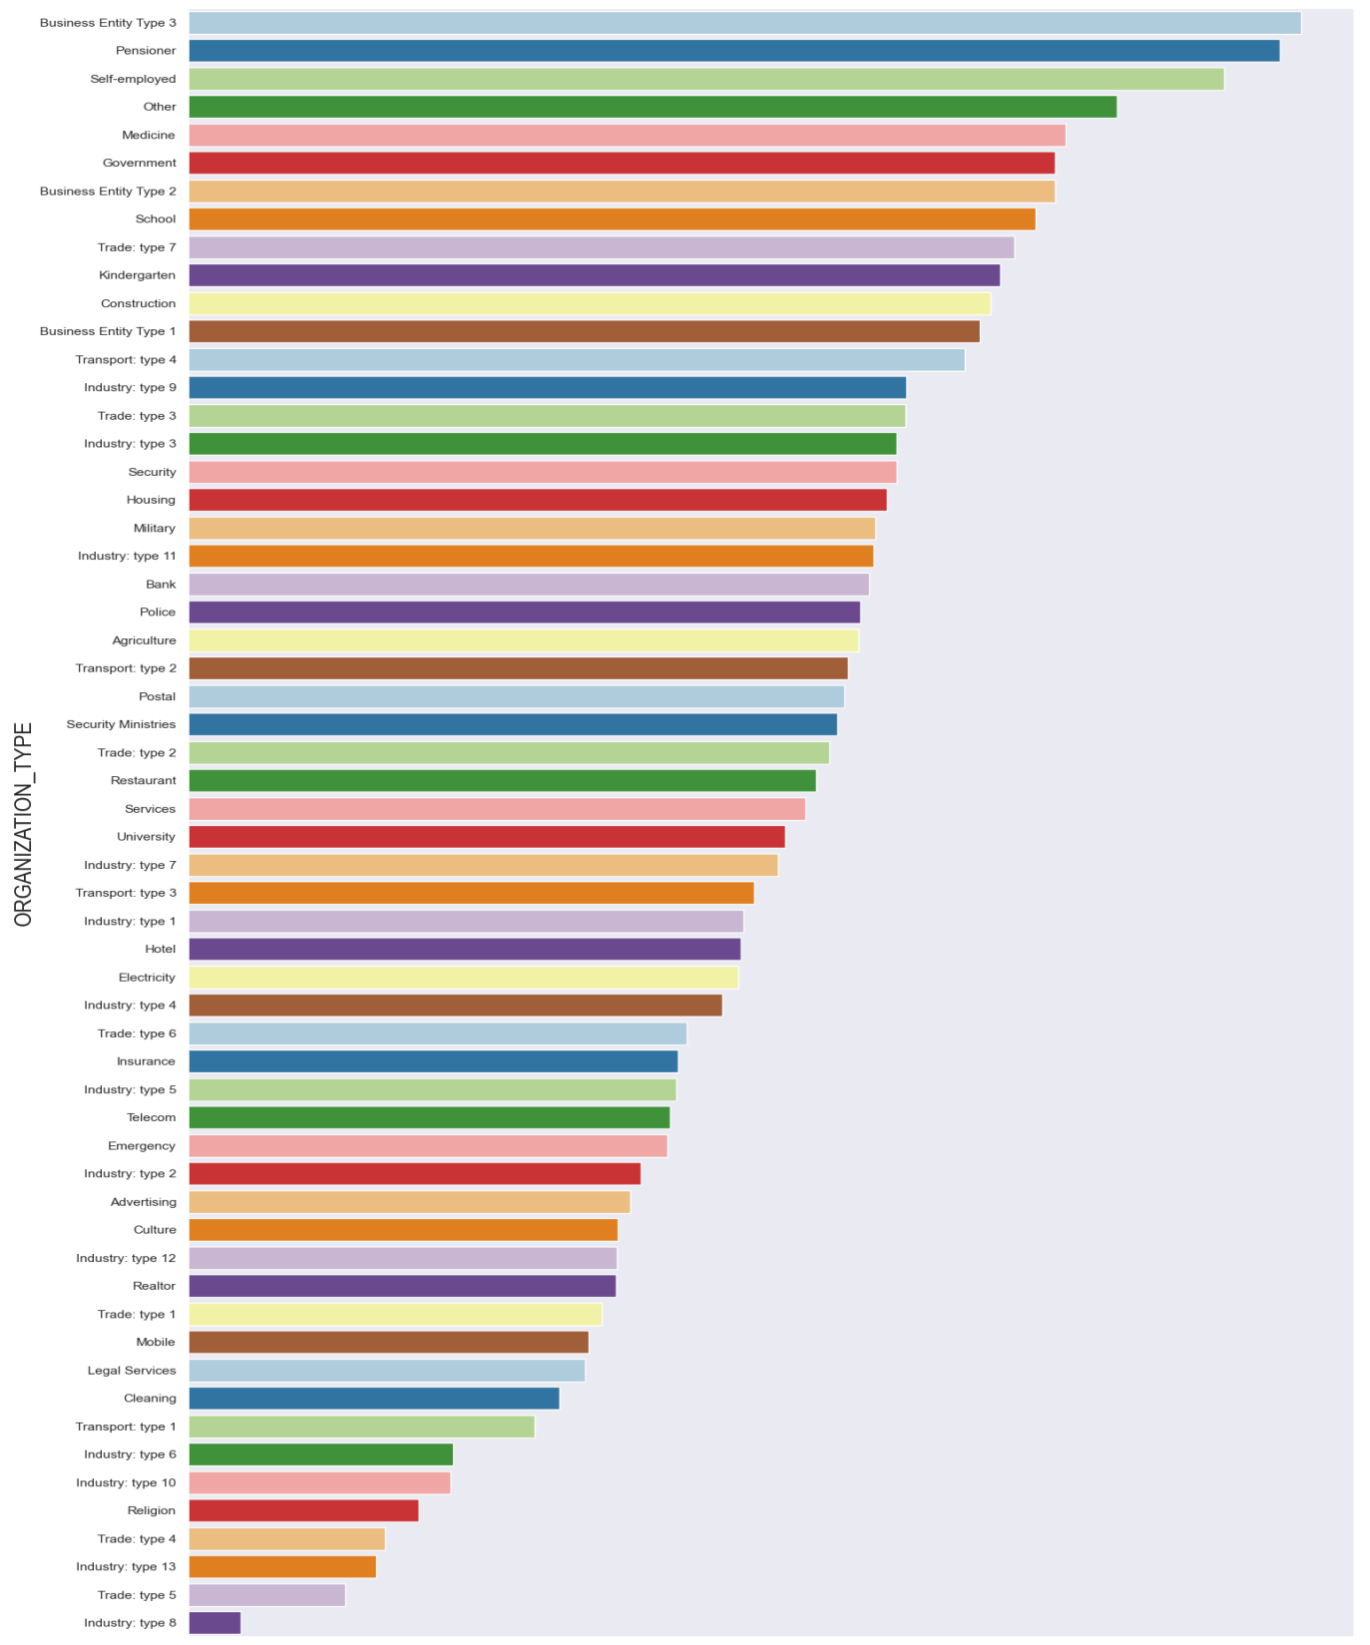
Organization Type distribution
Industry Type 8, Industry Type 5 are the least interested in taking credit
Employed, Business entity Type 3 ,Pensioner are the type of organisation which had applied credit maximum

Slide 9
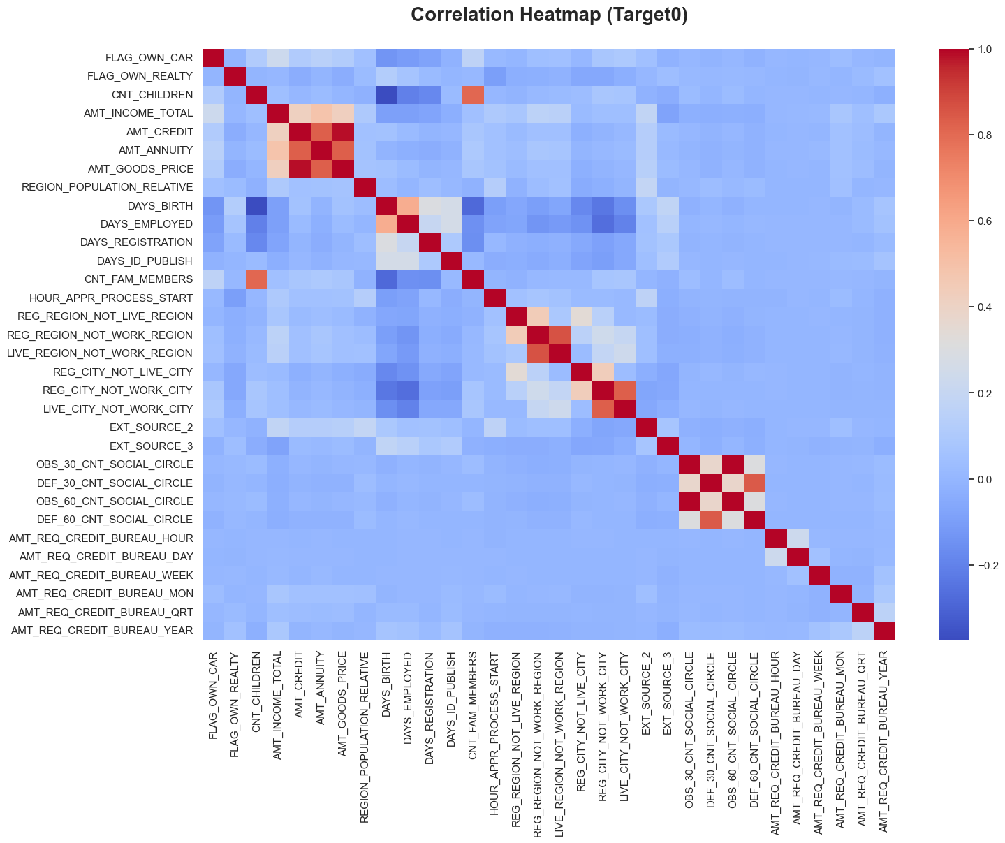
Correlation Heat map
AMT_INCOME_TOTAL AND AMT_CREDIT is higher in an area with a high population density
Parents had less children while living in a heavily populated location.
AMT_INCOME_TOTAL has an inverse relationship with CNT_CHILDREN, which suggests that customers had more income when they're parenting less.

Slide 10
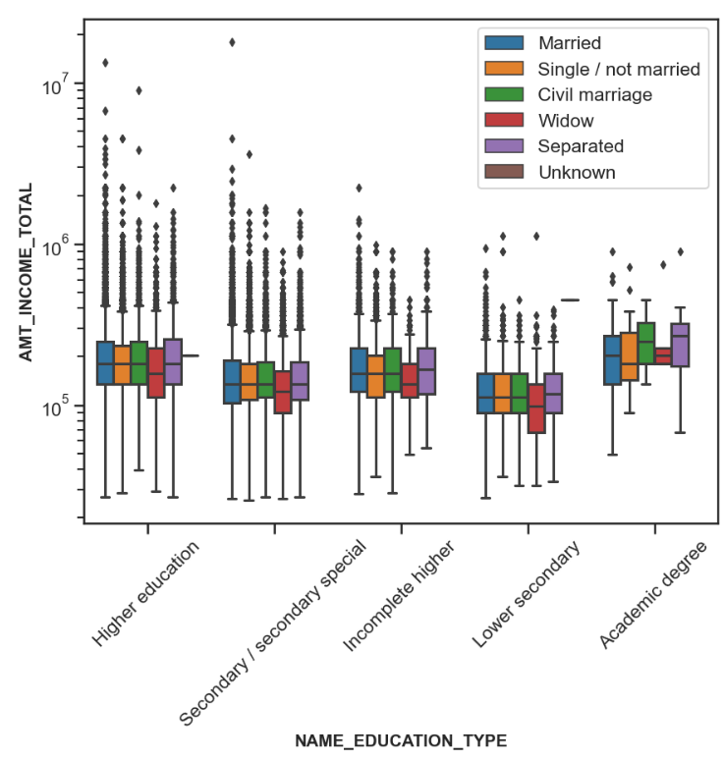
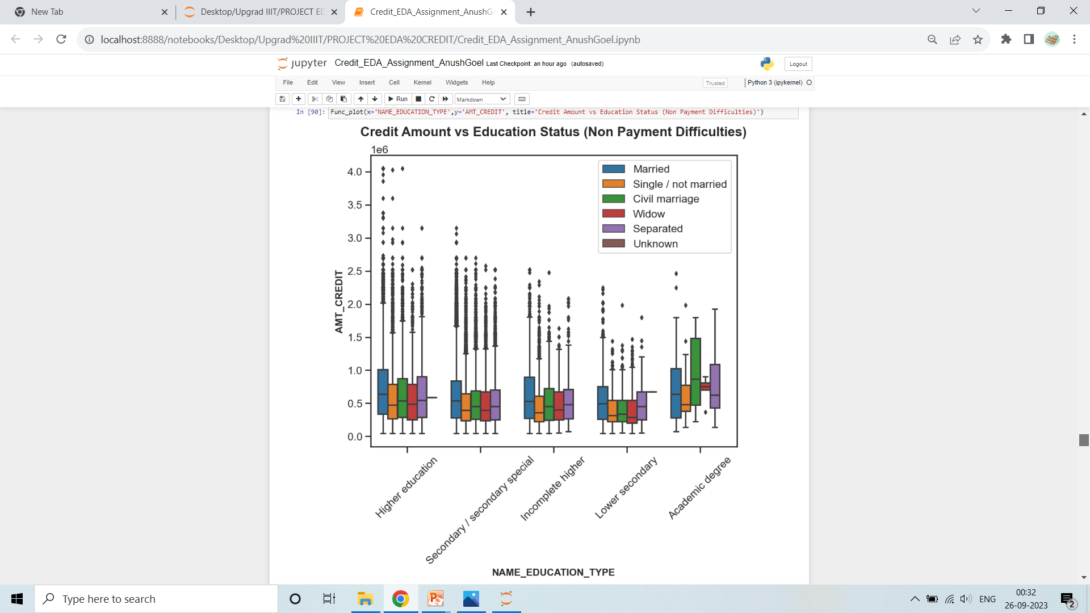
Bivariate Analysis
Customers with various types of education other than academic degrees possess a high percentage of outliers.
Apart from academic degree customers, all other education types are willing to take higher loans amount.
Family statuses of 'civil marriage,''marriage,' and'separated' of academic degree education have a larger number of credits than others.
greater education plus family status of'marriage,''single,' and 'civil marriage' constitute greater outliers.

Slide 11
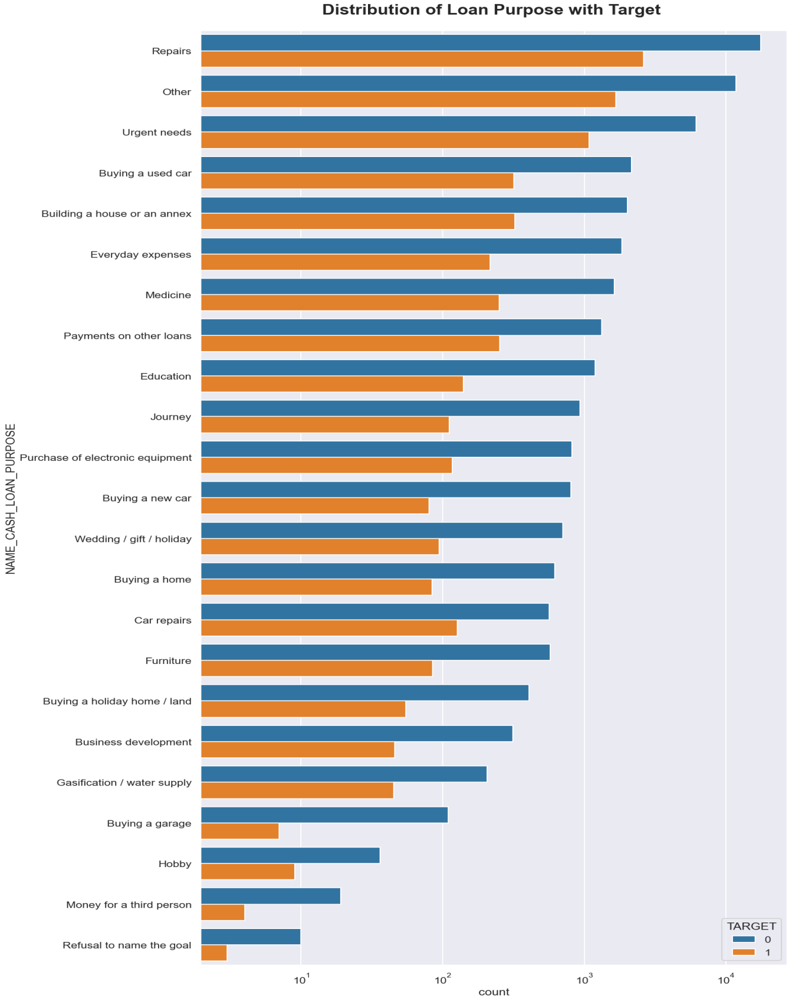
Distribution of Loan Purpose with Target (merged data)
Repairs are having increasing difficulty being paid on schedule.
Purchasing a garage, business development, purchasing property, purchasing a new vehicle, and education all have larger loan payments.

Slide 12
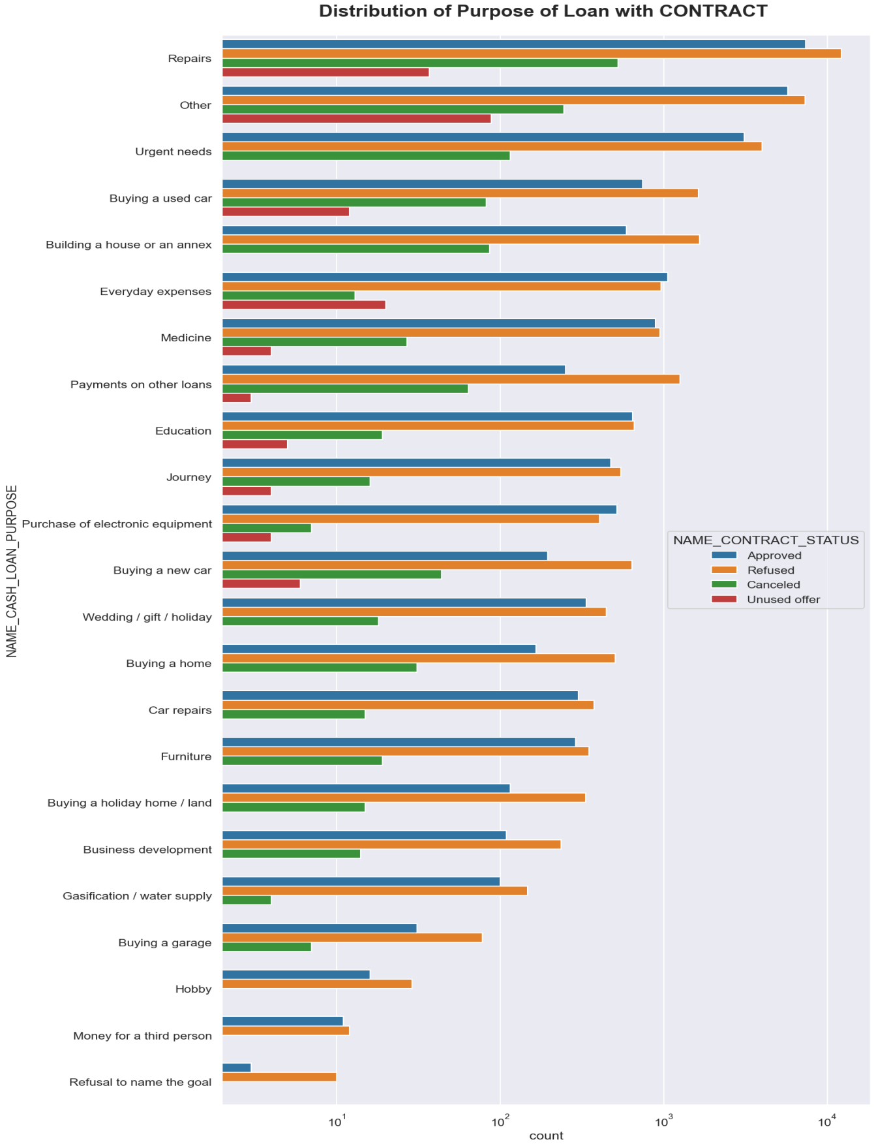
Distribution of Purpose of Loan with CONTRACT (merged data)
The majority of loan rejections were for'repairs'.
We have an equivalent number of approvals and rejections for educational purposes.
Paying off existing debts and purchasing new cars are receiving far more rejections than approvals.
Apart from purchasing new electronic equipment, all other purposes have a higher rejection rate as compared to approval rates.

Slide 13
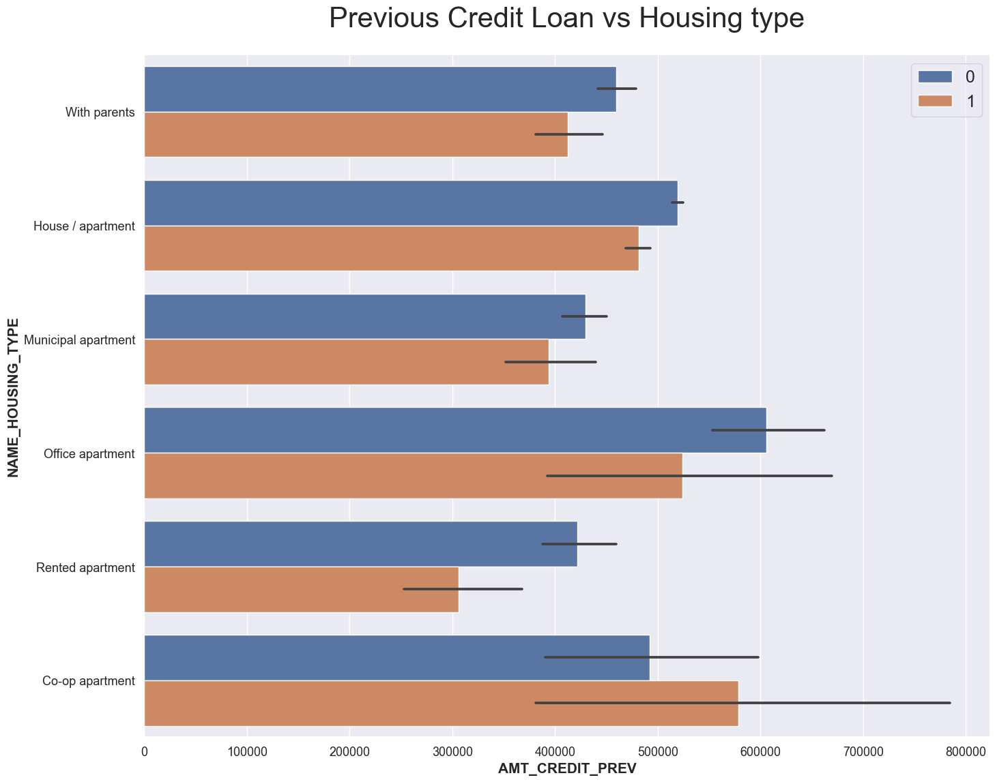
Previous Credit Loan vs Housing type (Merged Data)
Co-op apartments have higher credit of defaulters than office apartments do have more non-defaulters.
Regarding effective settlements, the bank can concentrate primarily on focusing on type categories like "municipal apartment or "with parents".

Slide 14
SUGGESTION (LESS CHANCE TO BE DEFAULTER)
The bank's primary focus should be on businessmen, students, or pensioner types of clients, as they have a great payment rate.
The bank can also focus on housing type (with parents) and target as many consumers who fall under this category, as they have the fewest failed payments.
Any client whose previous loan was approved
New clients who have never used loan facilities before
Clients with high income

Slide 15
SUGGESTION (RISKY GROUP)
The "repair" and (working type) income types have a higher percentage of unsuccessful payments.
Previously Refused Loan Status
Lower secondary clients have previous loan status as cancelled or refused, so financial institutions can aviod them.

